Slide 1
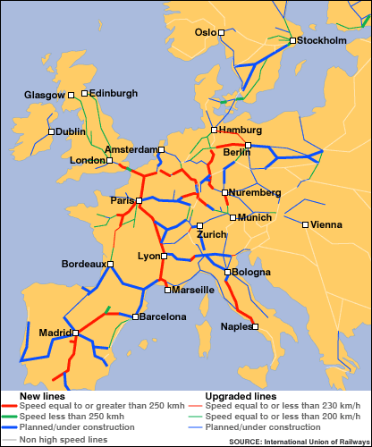
Station #1 - European Union – Transportation Corridor
Class Set – Do Not Write On
Map of the Major routes/roads in Europe- Lines represent roads
European Railroads
Why are these lines of transportation important to the European Union/Europe’s Economy?
What are some “things” that may be transported on these roads and railroads?
How might they have an impact on culture?

Slide 2
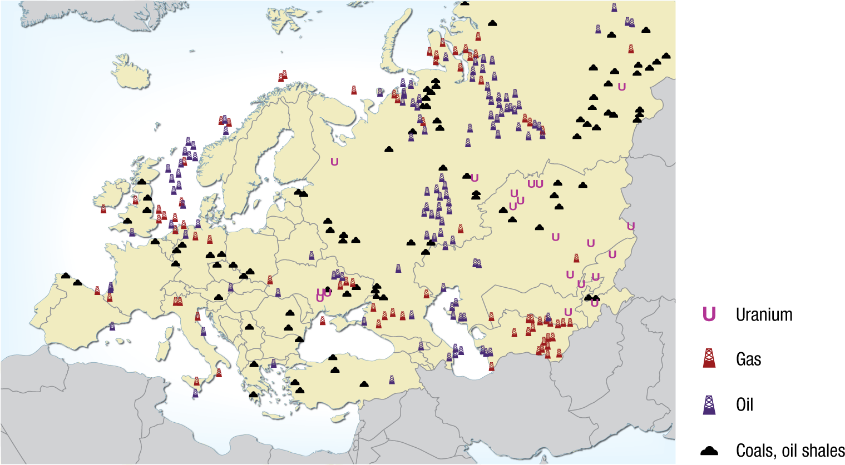
Station #2 - Natural Resources
Class Set – Do Not Write On
What are some trends that you notice about the map of resources?
How do countries benefit from having these resources?
Are there any countries with none of these resources? How do you think they make money?

Slide 3
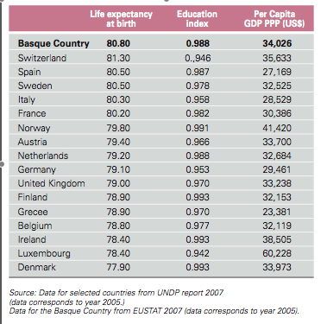
Station #3 - Standard of Living in Europe
Class Set – Do Not Write On
Standard of Living- A level of material comfort as measured by the goods, services, and luxuries available to an individual, group, or nation.
Use the chart to infer which countries would have the highest standard of living. Rank them 1 – being the highest to 10. You are only ranking who you feel are the top 10.

Slide 4
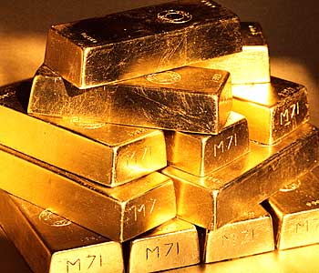
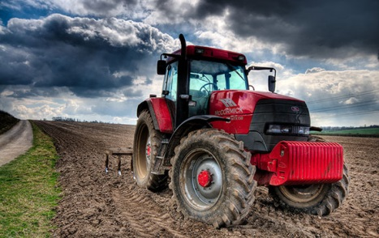
Station #4 -Entrepreneur/Capital in Europe
Class Set – Do Not Write On
Entrepreneur
Capital
A person or group of people that creates a new business.
Draw a picture that represents an entrepreneur and label it entrepreneur.
Wealth in the form of money or property, used or accumulated in a business by a person, partnership, or corporation.
Draw a picture that represents capital and label it capital.

Slide 5
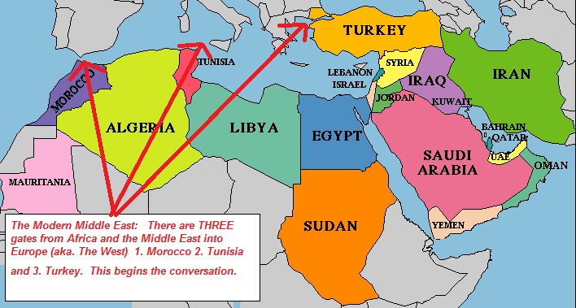
Station #5 - European Laborers
Class Set – Do Not Write On
People are predicting that Europe may not have enough workers in the future. This map shows people MIGRATING from Africa to Europe.
Why might this map offer a solution to that problem?
Why do you think people are currently moving from Africa to Europe? Give more than one reason and explain.

Slide 6
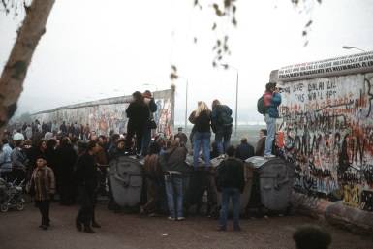
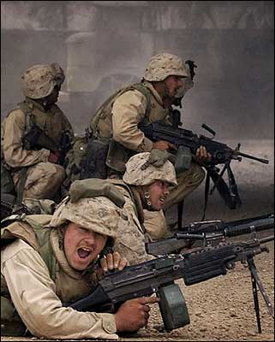
Station #6 - Cooperation Vs. Conflict
Class Set – Do Not Write On
Cooperation - Examples
Conflict - Examples
Treaty of Versailles
Berlin Wall coming down that separated East (Communistic) and West (Democratic) Germany
European Union
WWI
WWII
Cold War
Discuss the efforts of the European Union that we discussed previously.
What are some of their goals…economic and non-economic?
Why have so many countries wanted to join them?

Slide 7
What is the European Union?

Slide 8
What is the European Union?
It is the protection of workers in Europe.
It is the group of countries that work together to make it better.

Slide 9
Station #1 - European Union – Transportation Corridor
While you are watching the video, think about what makes this possible to travel through out Europe without stopping or paying extra taxes, and who does this benefit?

Slide 10
Station #1 - European Union – Transportation Corridor
The way Europe is set up, it makes it difficult for business to import/export items. However the road system is great.
Being apart of the European Union has allowed for people and business to travel more freely throughout the continent.

Slide 11
Station #2 - Natural Resources
In science we learned the different ways of producing energy, how can countries benefit from being apart of the European Union? How do countries contribute to producing energy if they don’t have resources to offer?

Slide 12
Station #2 - Natural Resources
Even though a country is apart of the EU and they don’t have any resources, they can contribute by trading goods and services in exchange for energy.
Even though a country is apart of the EU and they don’t have any resources, they will have to create a way to make energy in their own country.

Slide 13
Station #3 - Standard of Living in Europe
In these countries (especially in Europe), what do you think causes their country to be better than others (think more than just a beautiful place)?

Slide 14
Station #3 - Standard of Living in Europe
Country A and B are about the same size, same population. Country A has a higher standard of living than B because they just have more money.
Country A and B are about the same size, same population. Country A has a higher standard of living than B because they have a higher literacy rate which allows for better jobs.

Slide 15
Station #4 -Entrepreneur/Capital in Europe
What is an Entrepreneur? How might it effect a country’s economy? Who can be an entrepreneur and what does it take?

Slide 16
Station #4 -Entrepreneur/Capital in Europe
An entrepreneur is someone that works at home for computer company. Their job helps the economy and benefits the country by providing great customer service for tech support.
An entrepreneur sees a need in the community and tries to create a job/business for that need. It will create more jobs in the country.

Slide 17
Station #5 - European Laborers
Is the European Union more like states working together or independent countries looking out for themselves only? Workers can come from anywhere, but what makes it easy for people to get jobs in other countries than their own?

Slide 18
Station #5 - European Laborers
When you are apart of the European Union, you are able to pass through other countries without stopping or having a passport. This way you can work and live in another country like our states.
When you are apart of the European Union, you are able to pass through other countries but you have to stop and show a passport. This way you can’t work or live in another country.

Slide 19
Station #6 - Cooperation Vs. Conflict
Why do you think the European Union was formed? Do you think it takes a lot of cooperation to get tasks accomplished? Do you think that all of the countries working together will eliminate conflict in the future?

Slide 20
Station #6 - Cooperation Vs. Conflict
The EU was formed to create stronger relationships to prevent future human abuse. It is hard to work together but it can stop future conflicts but not necessarily eliminate it completely.
The EU was formed to create one government and economy. This way it is easier to have peace and it will be more similar to the United States.

