Slide 1
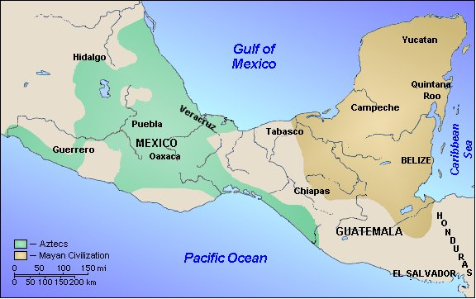
Middle America
Before and After 1492

Slide 2
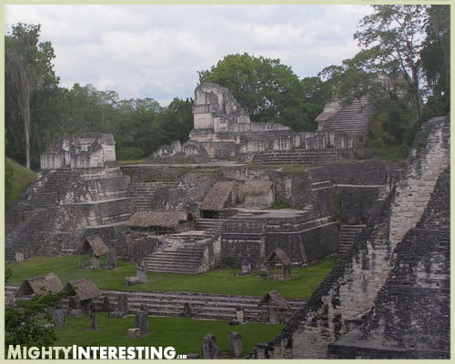
Maya & Aztecs had…
Established government
Began growing crops
Religion based (Polytheistic)
Designed elaborate buildings
Formed Languages
Created an economic system

Slide 3
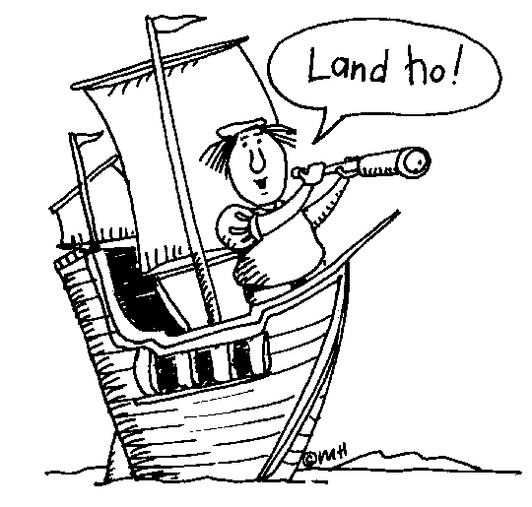
In 1492 Columbus Sailed the Ocean Blue…
Columbus sails West in exploration of a fast route to the east.
Discovered the Americas by accident
Called the people he saw Indians thinking he was in Indonesia.
That’s not Indonesia! … I’m gonna be famous!

Slide 4
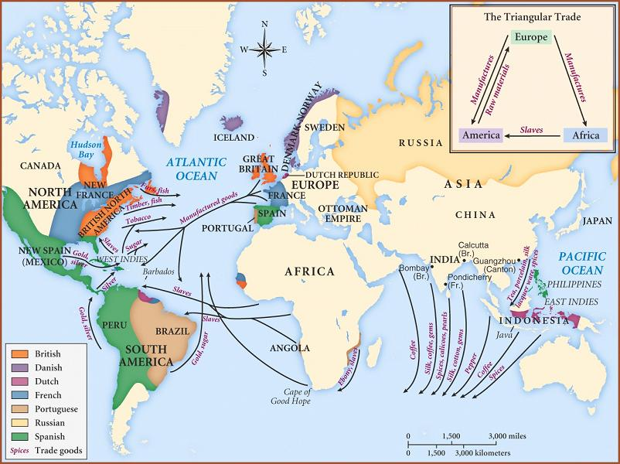
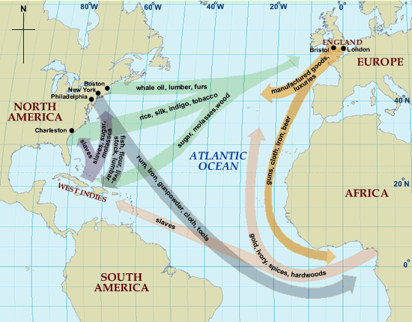
Question #1
In what ways do you think Columbus’ discovery changed the world as it was known? Use the map to generate ideas.

Slide 5
Exploration
Conquistadors-conquerors
Hernando Cortez- Conquered the Aztecs
Coronado- Searched for the 7 Cities of Gold.
Cortez Conquers the Aztecs Video

Slide 6
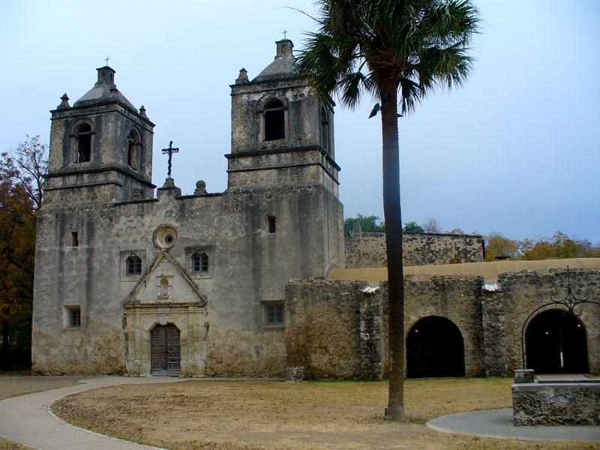
Colonization & Exploitation
Spanish race to Americas
God, Gold & Glory (The 3 G’s)
Spread Religion (God)
Search for valuable resources (Gold)
Claim land in the name of Spain (Glory)
Effects on Native Americans
Up to 80% of Native Americas die from disease (some say 90%)
Many become slaves on plantations
Because so many died, led to Spanish importing slaves from Africa.
Forced to change culture (Mainly religion)

Slide 7
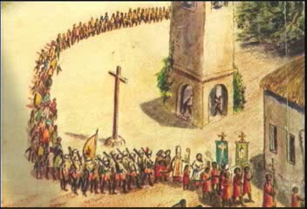
Spread of Religion

Slide 8
Question #2
Knowing what we know now, do you agree that the Spanish and other countries should have colonized other countries? Why or Why not?
If you said no, how might that have changed us today?

Slide 9
Colonization Led To…
Blend of Spanish and Native cultures in most areas (*exception Haiti-French)
Loss of religion (Became Christian)
Loss of language (Became Spanish)
Loss of land to the Spanish
Africans (through slavery) also brought their culture
Calypso Music, dance ect.
http://www.youtube.com/watch?v=t8bmLhdoKZI

Slide 10
HAITI –FRENCH Culture

Slide 11
Ancient Culture to Today
Aztec - Maya
Mexico/Central America Today
Language
Religion
Architecture
Travel
Language
Religion
Architecture
Travel
Why did the Spanish culture remain after the countries gained their independence? Why not go back to the traditional Aztec and Mayan way of life?

